Slide 1
TYPICAL member spot checks & alternate systems design study
James w. & Frances G. McGlothlin Medical Education Center

Slide 2
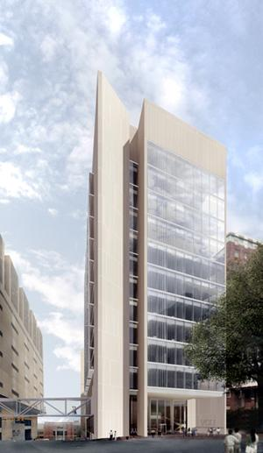
James W. & Frances G. McGlothlin Medical Education Center
Location: Richmond, VA
Owner: Virginia Commonwealth University
College: School of Medicine
Type: Multipurpose Education Facility
Functions: Administrative/Classrooms/Research
Size: 220,000 GSF
Height: 13 Stories (above ground)
Schedule: October 2009 to March 2013
Cost: $159 million
LEED: Designed for Silver Certification

Slide 3
Structural System Overview
Foundation – Framing – floor – lateral – roof - bridge

Slide 4
Structural System overview
Foundation System –
  Drilled Piers of 3 Sizes
    ≤ 450 k – straight shaft drilled piers
    730 k to 1640 k – single-belled caissons
    ≥ 1640 k – double-belled caissons
  Caissons + Grade Beams over existing pile caps
Floor/Framing Systems –
  Floors – composite concrete & steel system
  Columns – range from W10 x 88 to W14 x 455
  Beams – composite system – typically W18 x 35 – 30’ lengths
  Girders – range in size based on bay

Slide 5
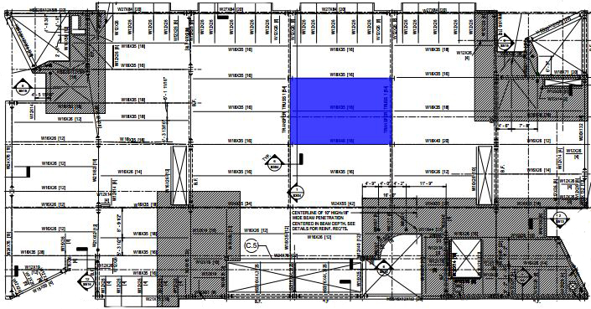
Structural system overview
Typical Bays –

Slide 6
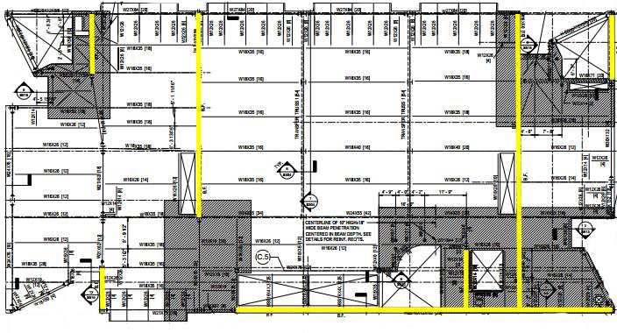
Structural system overview
Lateral System – 7 braced frames

Slide 7
Structural System Overview
Roofing System –
  1 ½”, 18 gage wide-rib steel decking with EPDM
  Solar reflectance for LEED certification requirements
Bridge to Main Hospital –
  Connects 2nd Floor to 1st Floor of Main Hospital
  Travels across major intersection
  About 65’ long & 14’ – 6” high
  Slab-on-Deck + HSS Steel

Slide 8
Typical Member spot checks
Gravity Loads

Slide 9
Typical member Spot checks
Member |  | Spot Check | Actual
Slab/Deck |  | 3VLI19 deck + 3 ¼” LTWT conc | 3VLI20 deck + 3 ½” LTWT conc
Beams |  | W18 x 35 [16 studs] (Floors 4 to 12) | W18 x 35 [16 studs] (Floors 4 to 12)
Girders | “Short” | W21 x 44 [20 studs] | W18 x 65 [6 studs]
 | “Long” | W24 x 76 [34 studs] | W18 x 211 [36 studs]
Columns | Interior | W14 x 132 – braced @ 20’ – 0” | W14 x 145 – braced @ 28’ – 0”
 | Exterior | W14 x 283 – braced @ 40’ – 0” | W14 x 398 – braced @ 36’ – 0”

Slide 10
Alternate system Design study
Overviews & Summary

Slide 11
Non-composite steel with bar joists
Summary:
  Slab – 1.0C24 deck + 2 ½” NW concrete (total depth=3 ½”)
  Bar Joists – 24K9 @ 4’- 0”
  Girders – W24 x 146
Bay Size: 30’ x 4o’
Potential Cost: Moderate (16 to 20 $/sf)
Lateral System: N/A
Schedule Impact: Increased (longer lead time)
Constructability: Easy
Viable Option? Possible

Slide 12
Pre-cast concrete planks on structural steel
Summary:
  Slab – 8” x 4’ hollowcore pre-stressed planks + 2” NW concrete
  Beams – W21 x 44
  Girders – W33 x 130
Bay Size: 30’ x 40’
Potential Cost: High ( > 22 $/sf)
Lateral System: N/A
Schedule Impact: Increased (requires more coordination)
Constructability: Easy
Viable Option? Not Likely

Slide 13
One-way reinforced slab with beams
Summary:
  Slab – 5” thick – #4 bars @ 12” o.c.
  Beams – 12” x 21” – (4)#8 bars [top] + (3)#8 bars [bottom]
  Girders – 12” x 14” – (4)#6 bars [top] + (3)#6 bars [bottom]
Bay Size: 30’ x 2o’
Potential Cost: Moderate (15 to 18 $/sf)
Lateral System: Change to Shear Walls
Schedule Impact: Increased (formwork/curing time)
Constructability: Moderate
Viable Option? Not Likely

Slide 14
Considerations | Systems
 | Existing – Composite Deck + Beams/Girders | Non-Composite Deck + Bar Joists/Girder | Pre-Cast Concrete Planks on Structural Steel | One-Way Reinforced Slab with Beams
Weight | 52 psf | 54 psf | 64.5 psf | 110 psf
Depth | 27” | 28” | 43” | 26”
Cost | Moderate | Moderate | High | Moderate
Bay Size | 30’ x 4o’ | 30’ x 40’ | 30’ x 40’ | 30’ x 20’
Floor-to-Floor Ht | --- | Decreased | Decreased | Increased
Fire Rating | 2 hr | 2 hr | 2 hr | 2 hr
Lateral Impact | --- | None | None | Shear Walls
Foundation Impact | --- | None | None | Increased
Schedule Impact | --- | Increased | Increased | Increased
Constructability | Moderate | Easy | Easy | Moderate
Deflection | 0.85” | 1.04” | 0.98” | Meets ACI 318-11
Vibration Control | Fair | Fair | Moderate | Best
Possible or Not | --- | Possible | Not Likely | Not Likely
Reasoning | --- | --- | Depth + Cost | Bay + Lateral + Foundation

